Slide 1
Housing Prices Regression Model

Slide 2
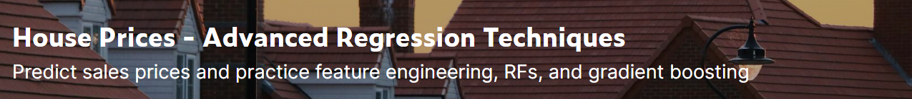
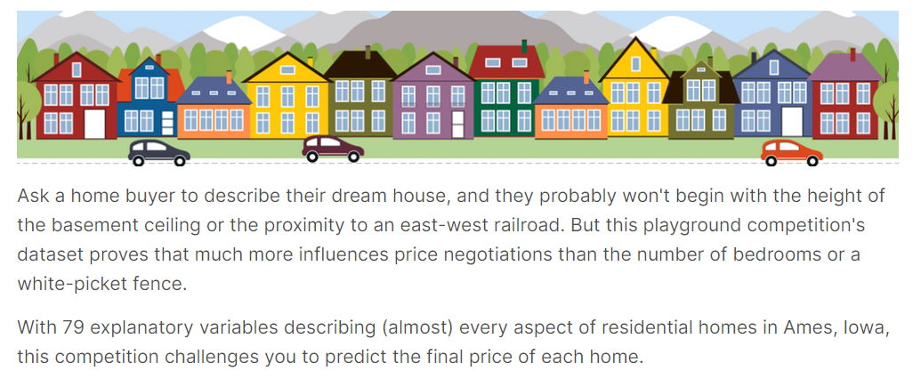
About the Dataset

Slide 3
Project Description/Background
Thorough EDA and preprocessing techniques to clean data and allow it to build the best models possible
Utilizing Regression Prediction Models to predict housing prices based on different attributes
Calculating the RMSE (root mean square error) allows us to track the success of each of these prediction models
Implementing stacking algorithm to produce a Meta Model that gives us the best results
Performing hyperparameter tuning on these models to get optimal parameters and improve RMSE
Submitting stacked models to Kaggle to track our success on the project

Slide 4
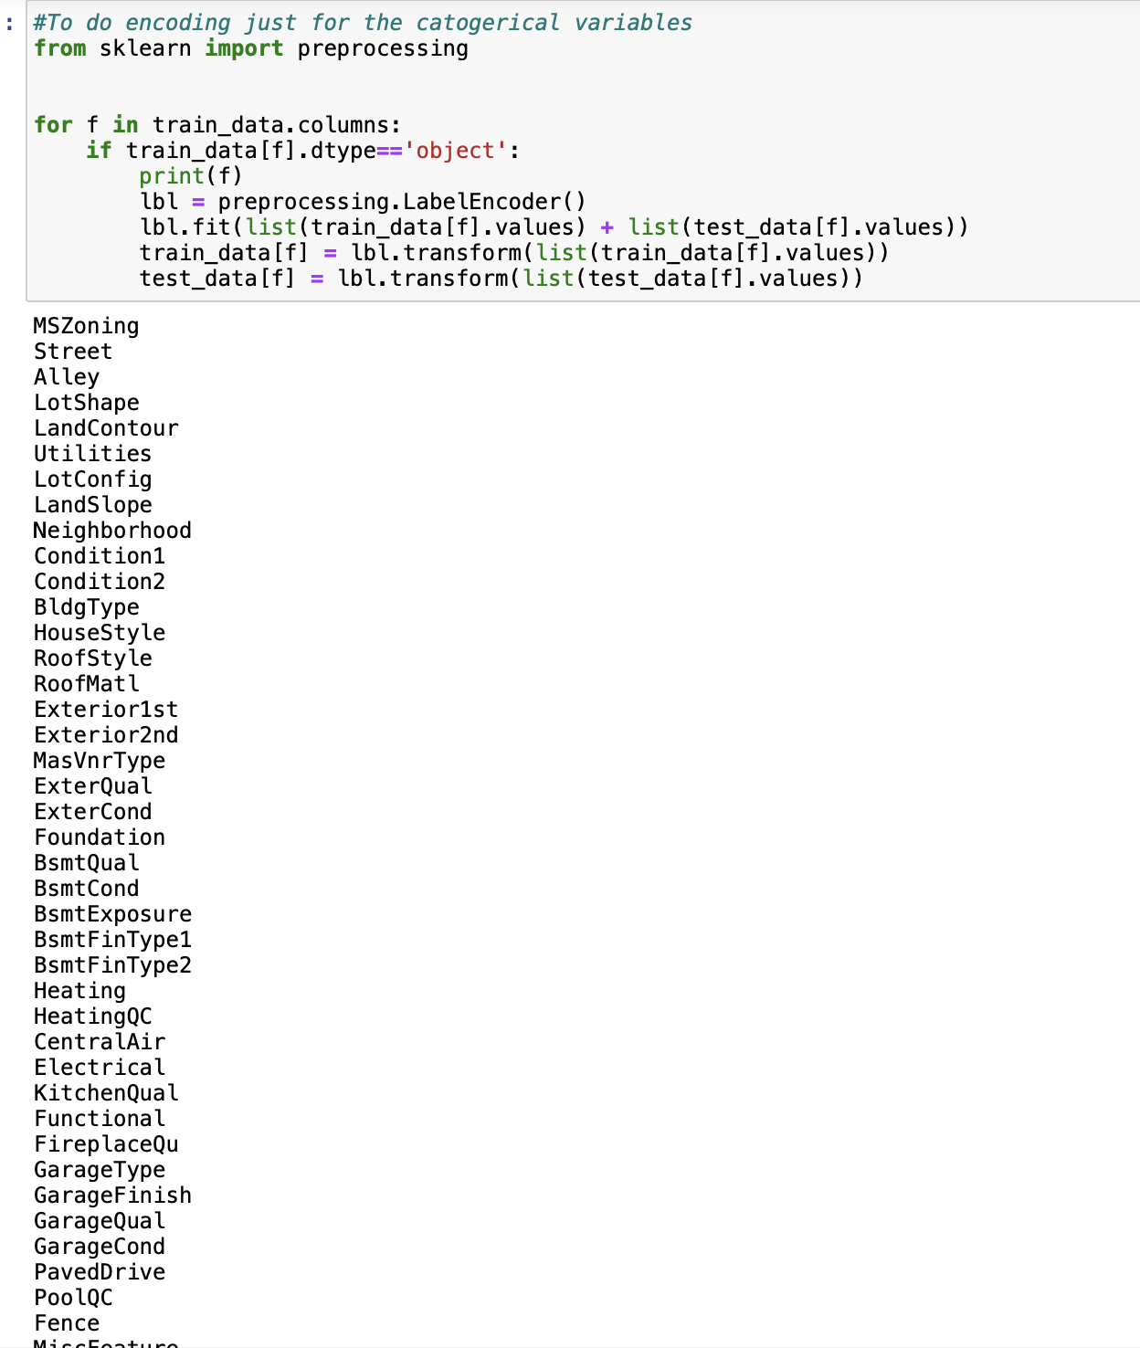
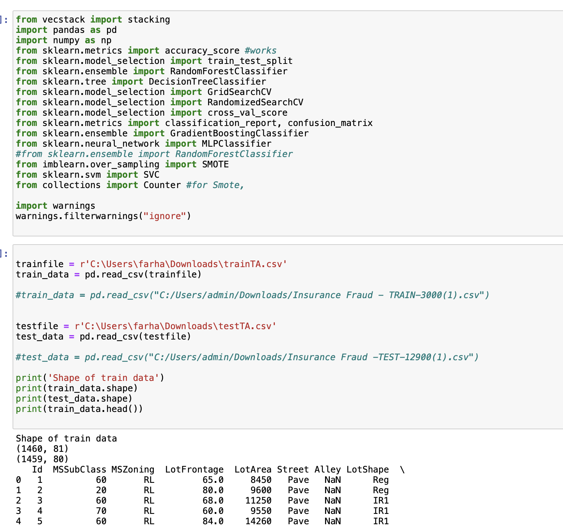

Slide 5
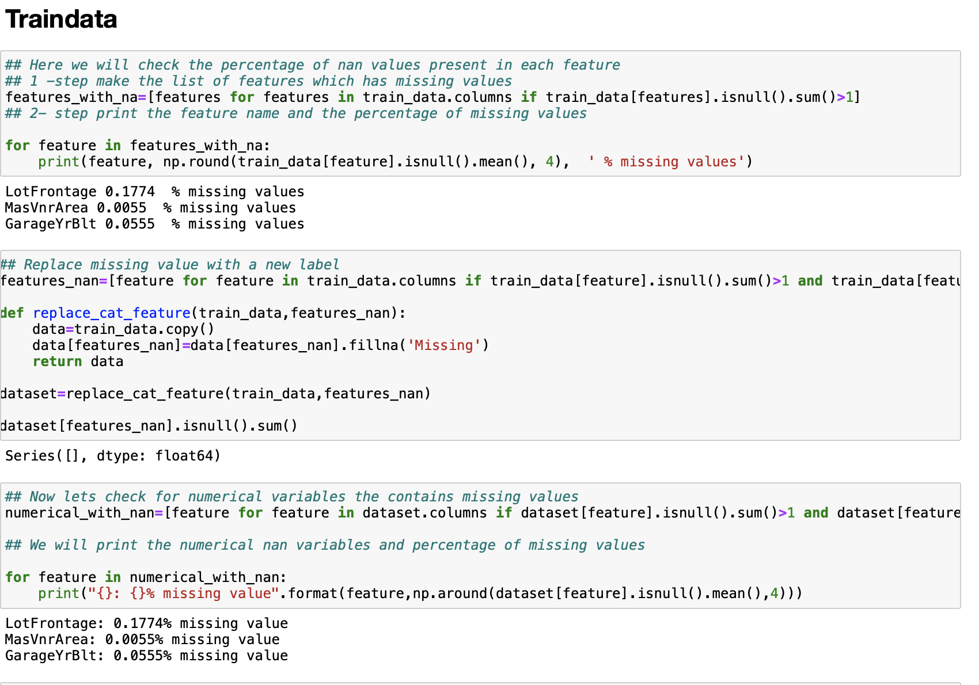

Slide 6
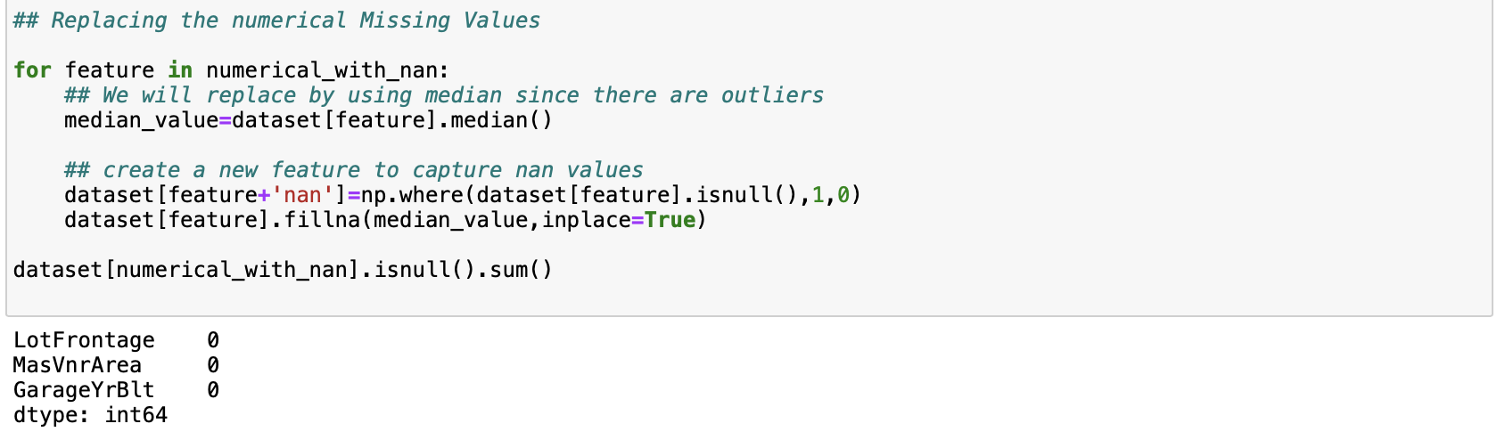
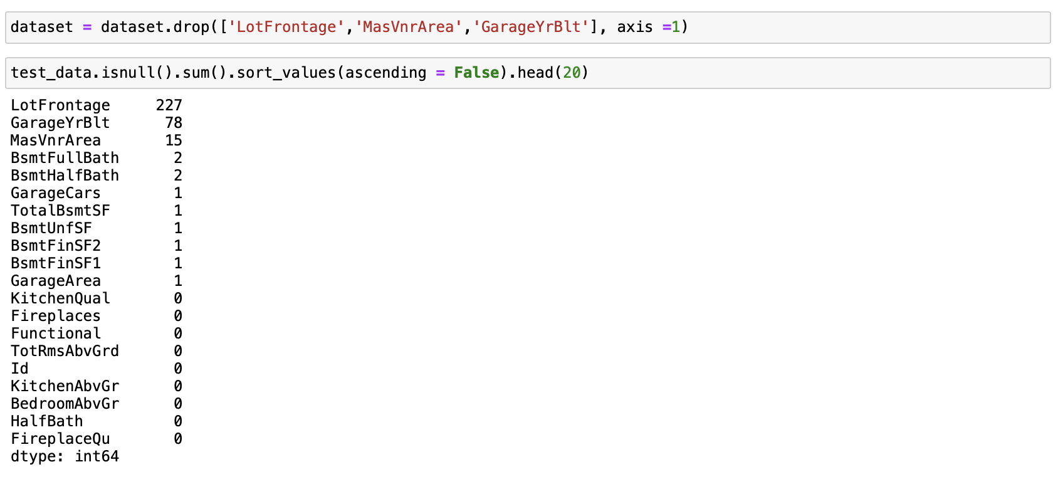

Slide 7
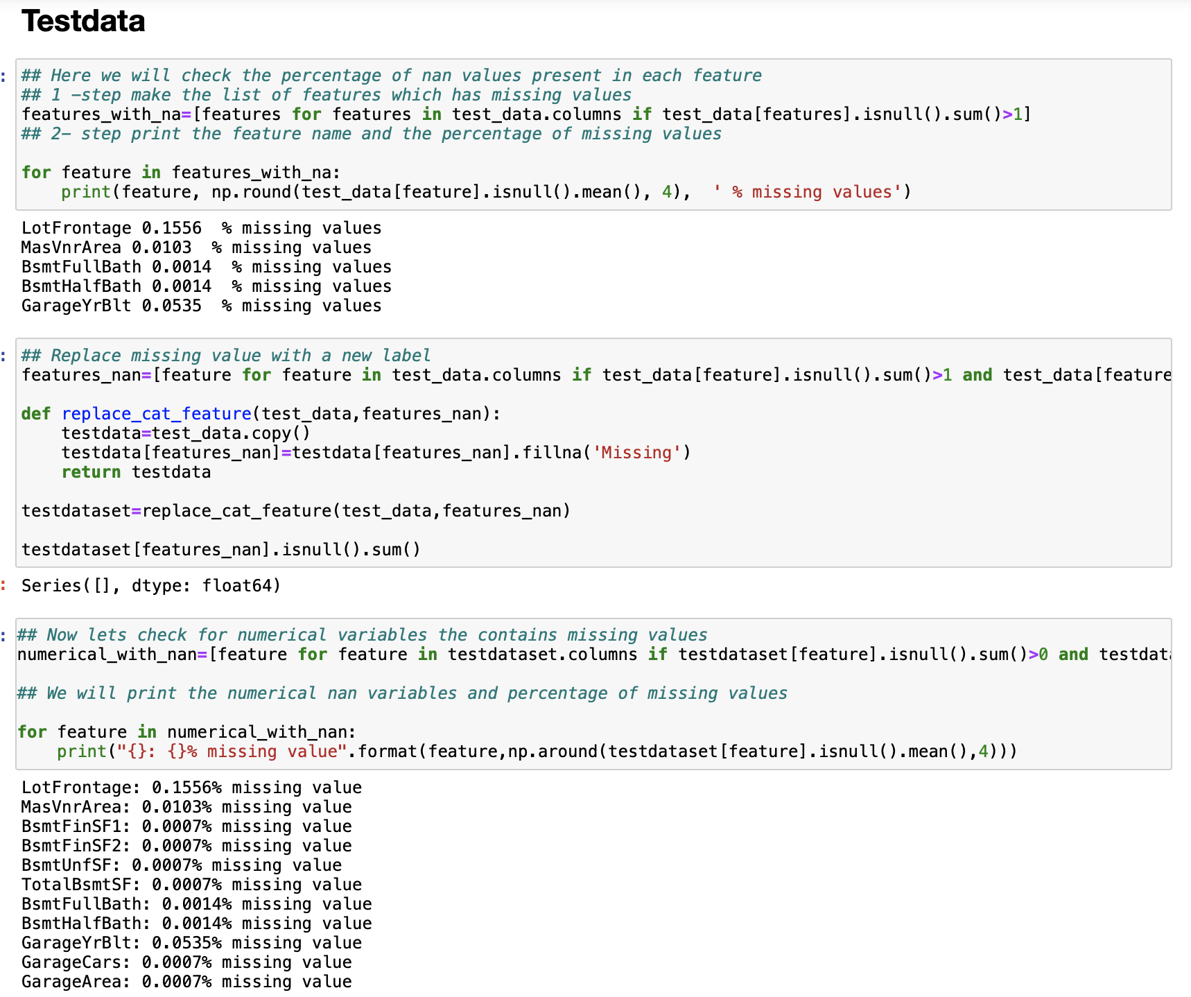

Slide 8
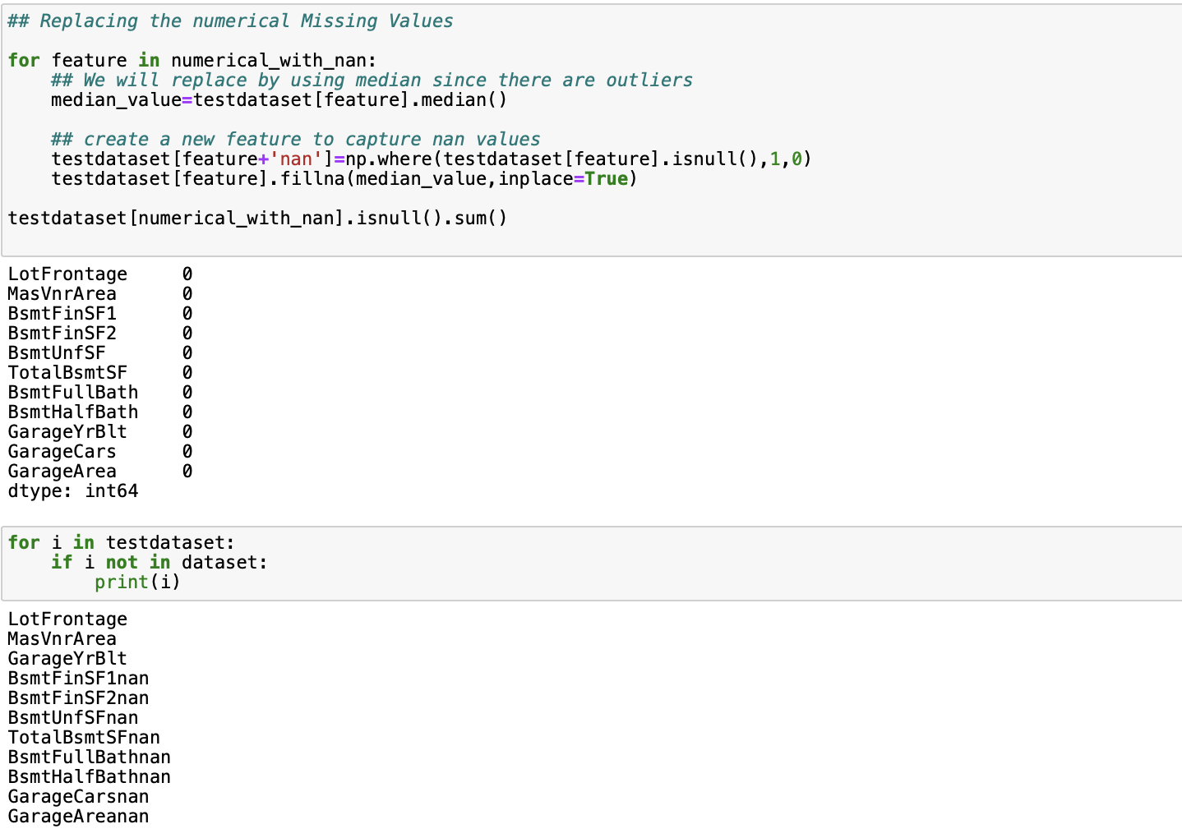

Slide 9
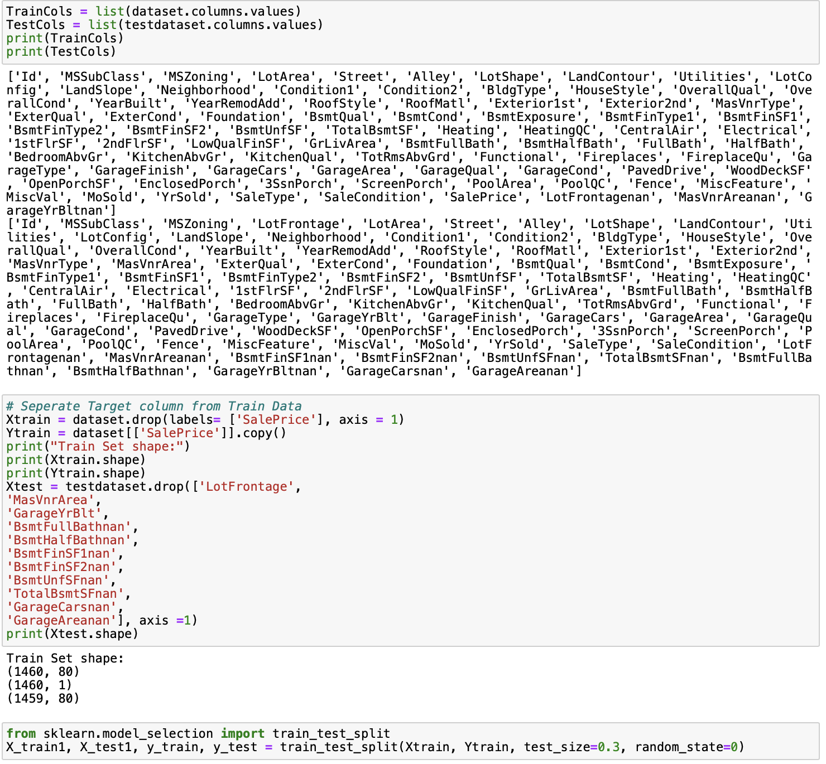

Slide 10
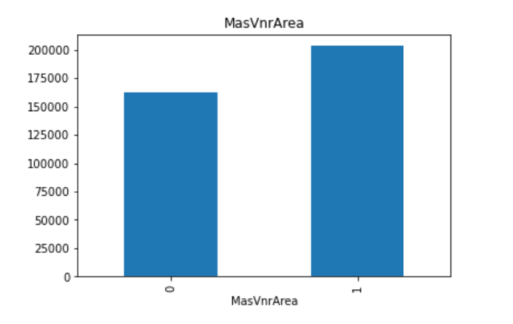
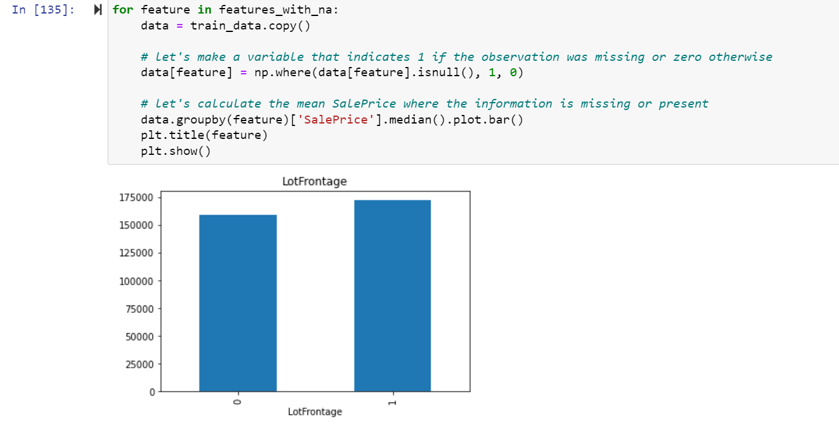
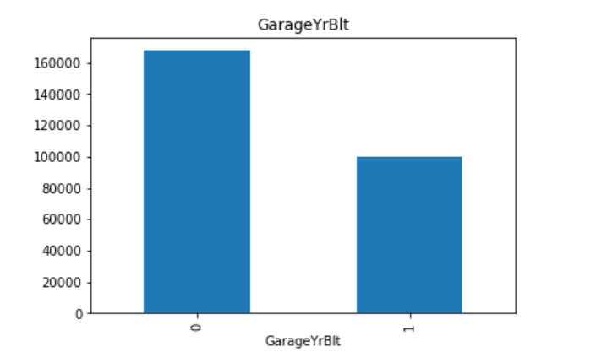
Visualizations

Slide 11
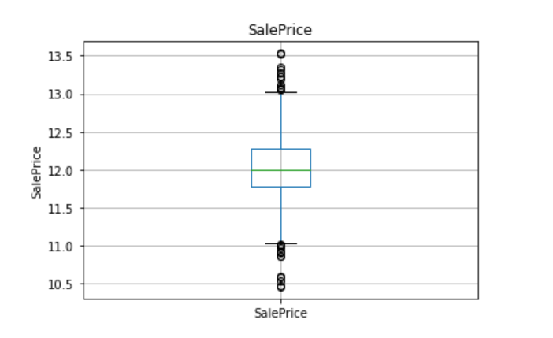
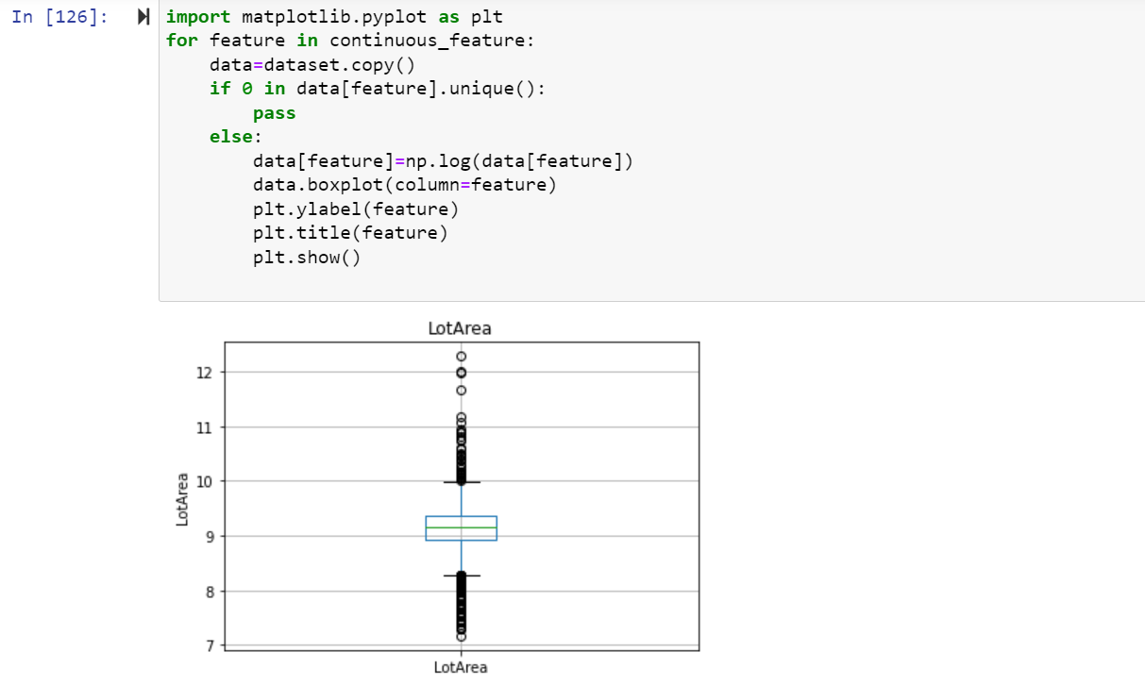
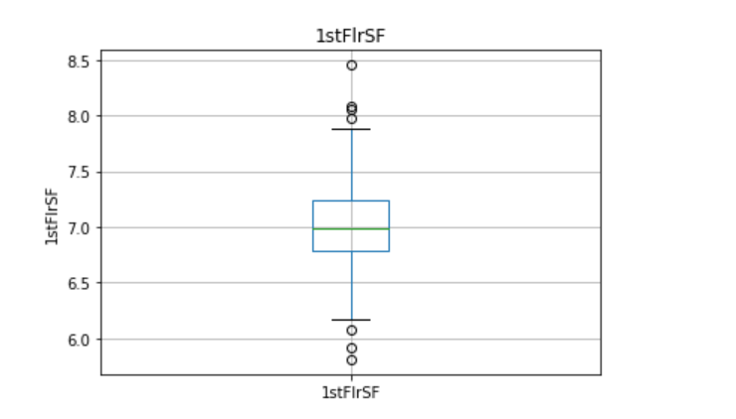
Visualizations

Slide 12
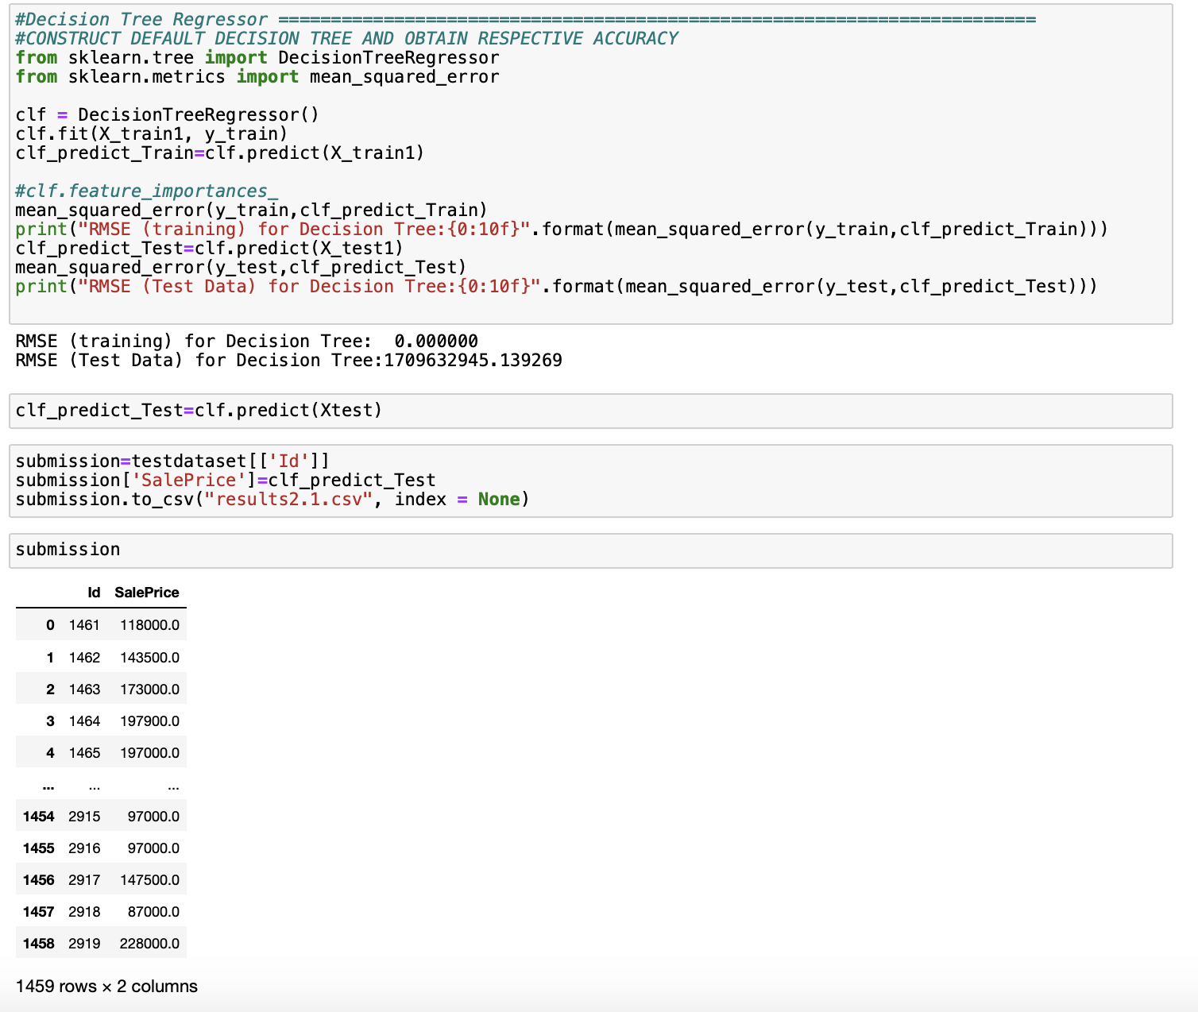

Slide 13
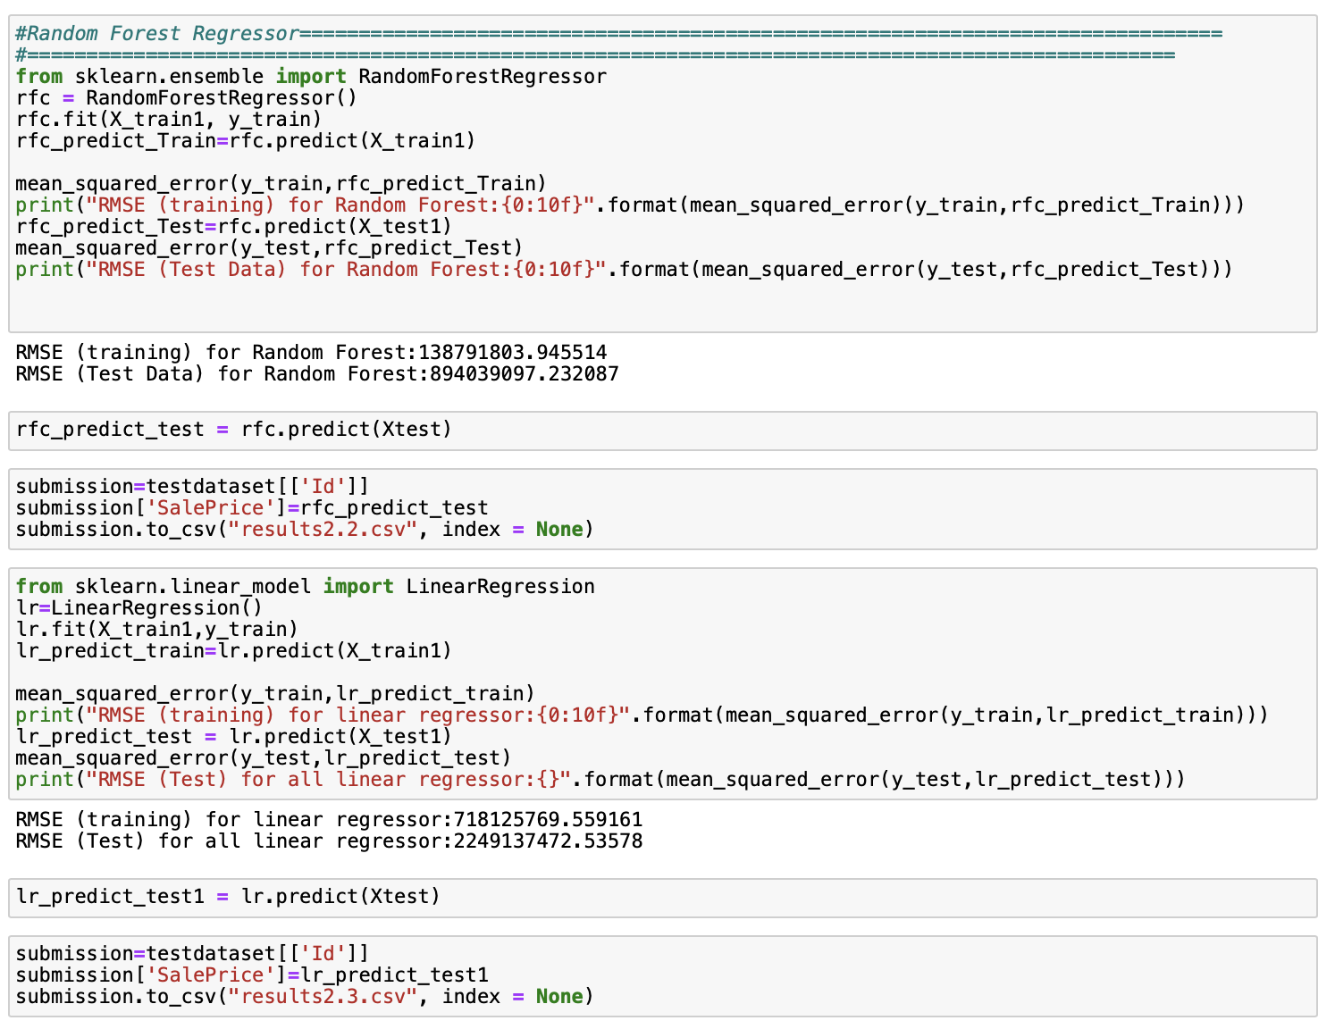

Slide 14
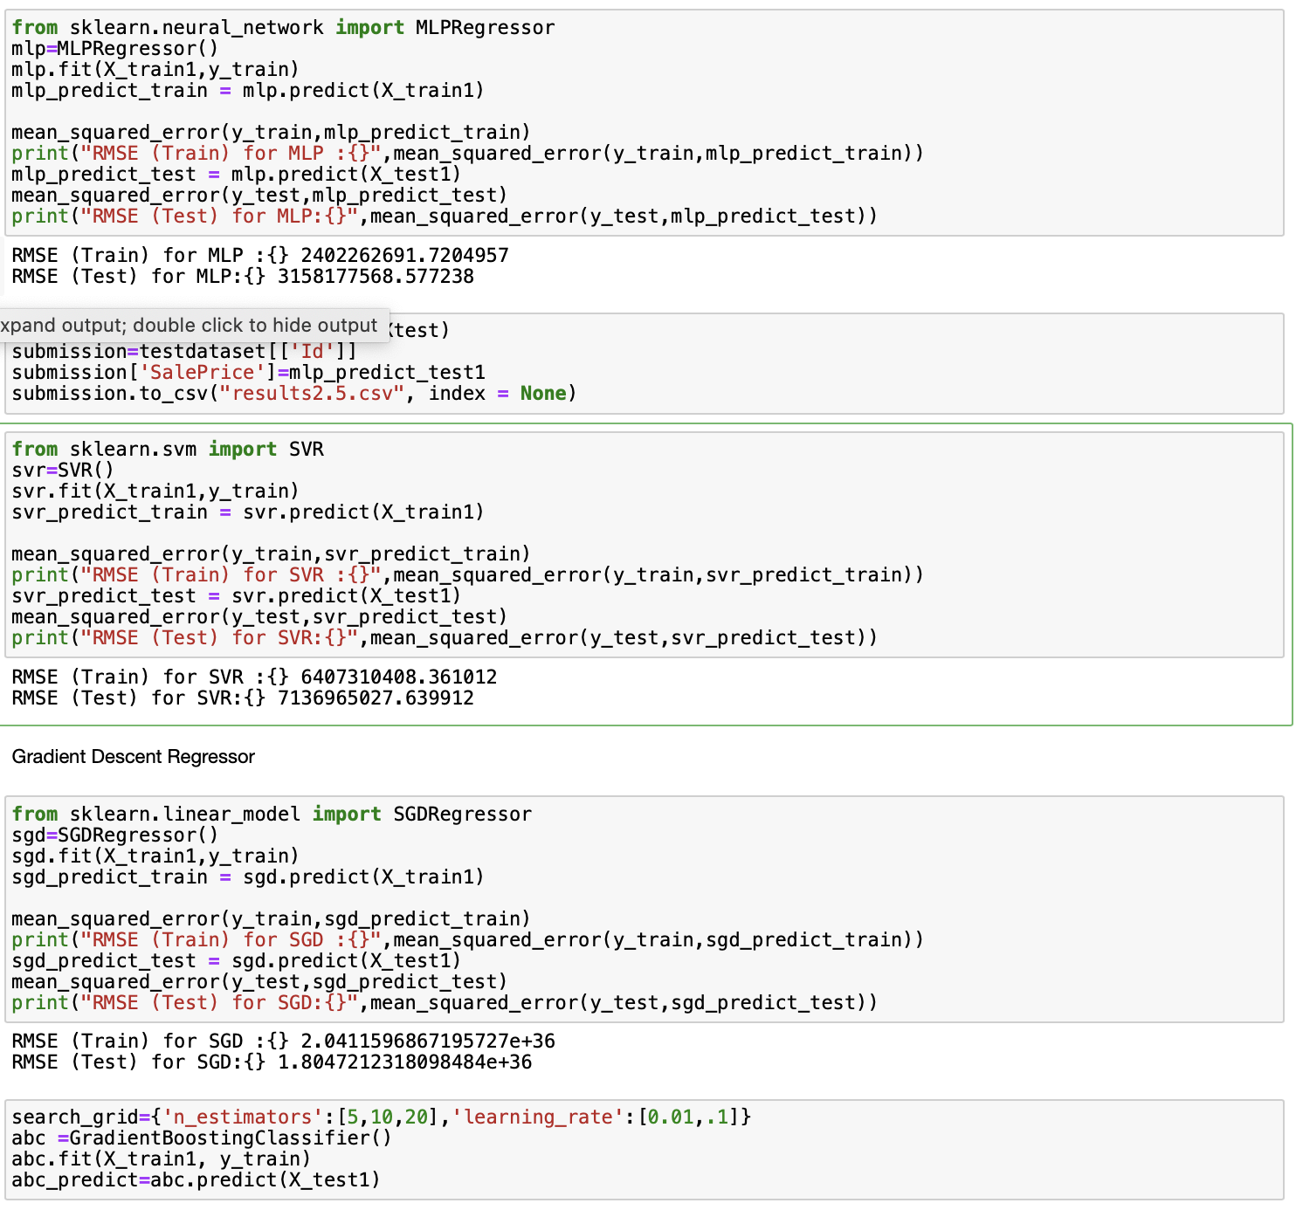

Slide 15
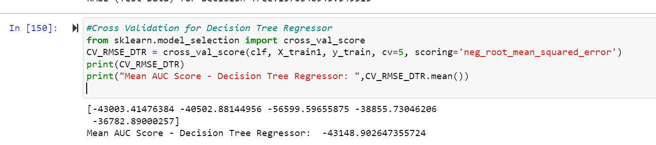
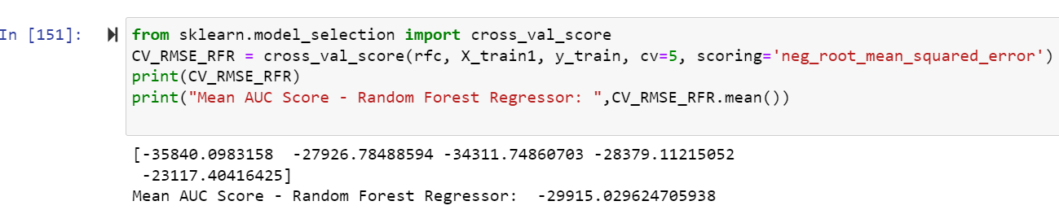
Cross Validation on Individual Models Based on RMSE

Slide 16
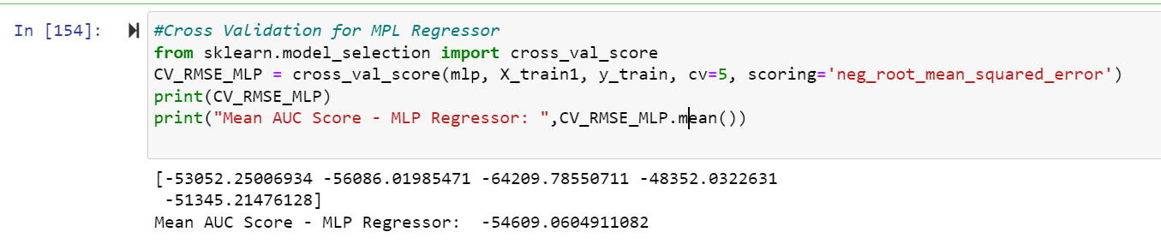

Slide 17
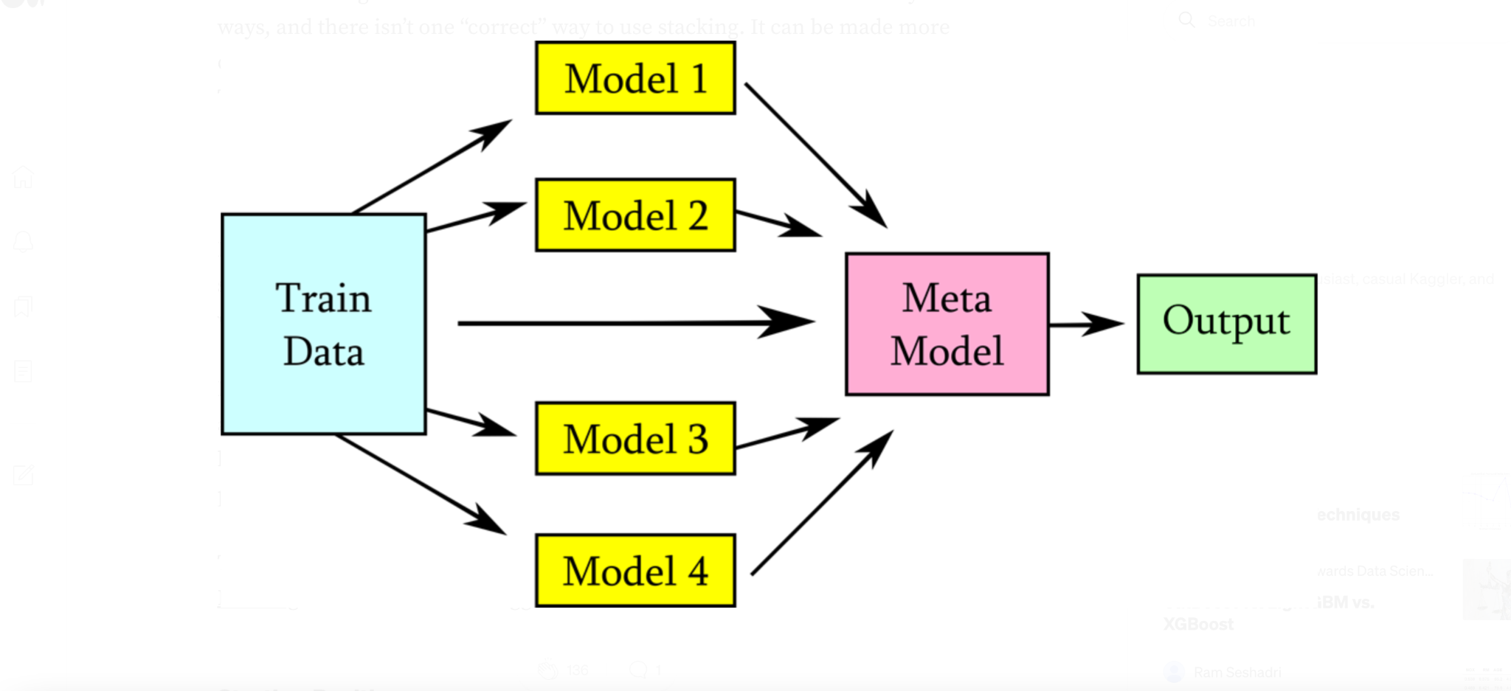
Model Stacking
Stacking is a combination the strengths of multiple models , makes the predictions more accurate as it combines the best of all the models, into a powerful model.
Stacked models combine less efficient learners as a whole and produce better results.
we make predictions with several different models, and then use those predictions as features for a higher-level meta model. It can work especially well with varied types of lower-level learners, all contributing different strengths to the meta model.

Slide 18
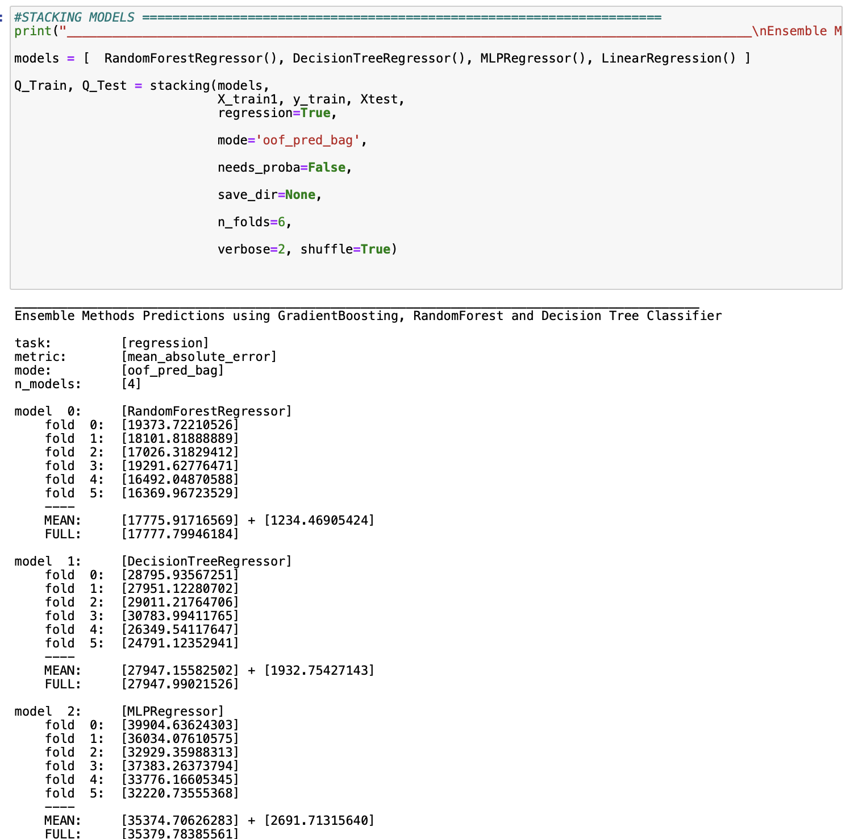
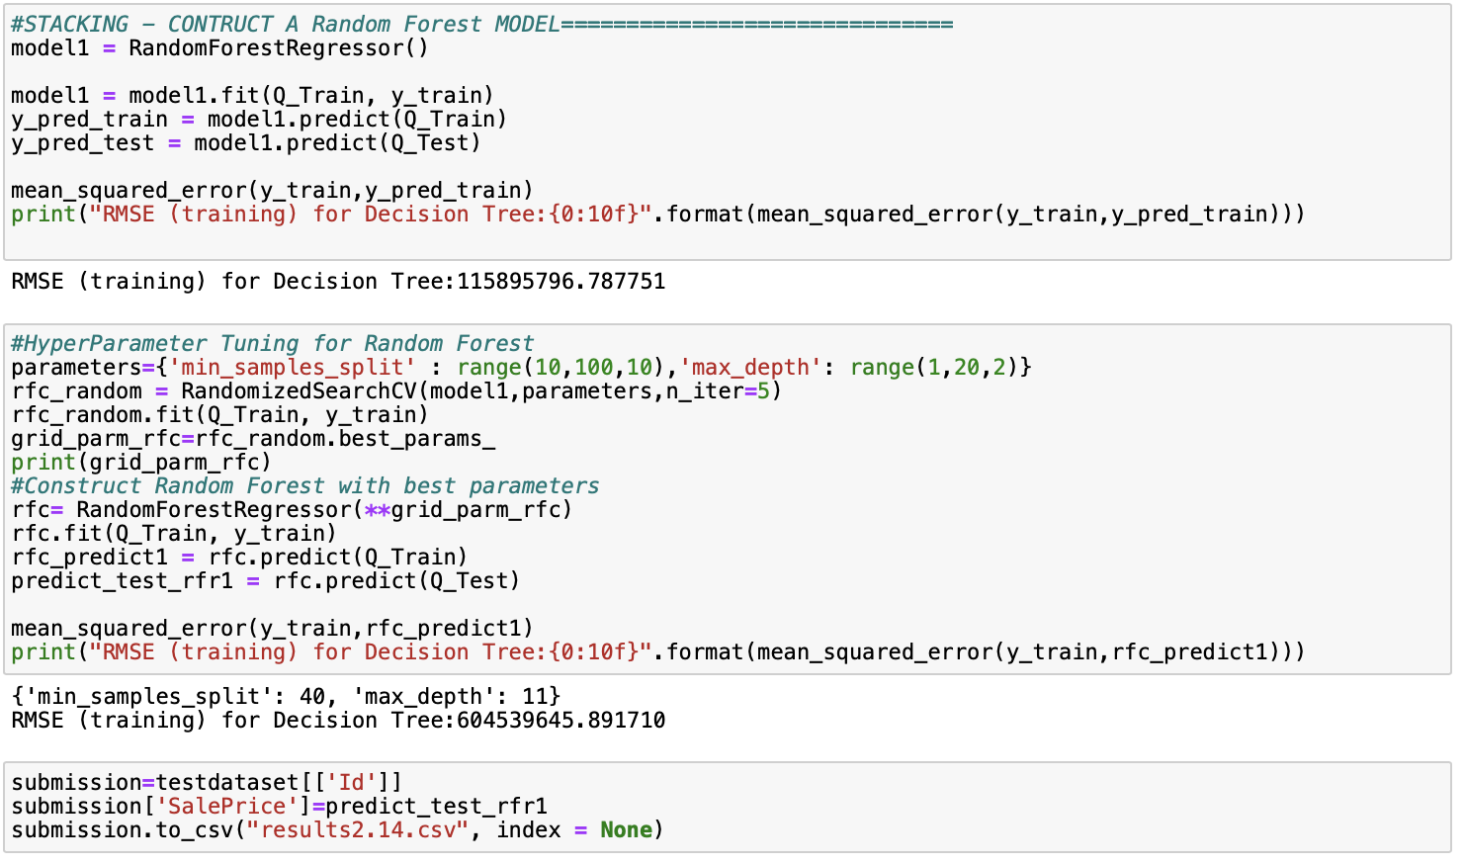

Slide 19
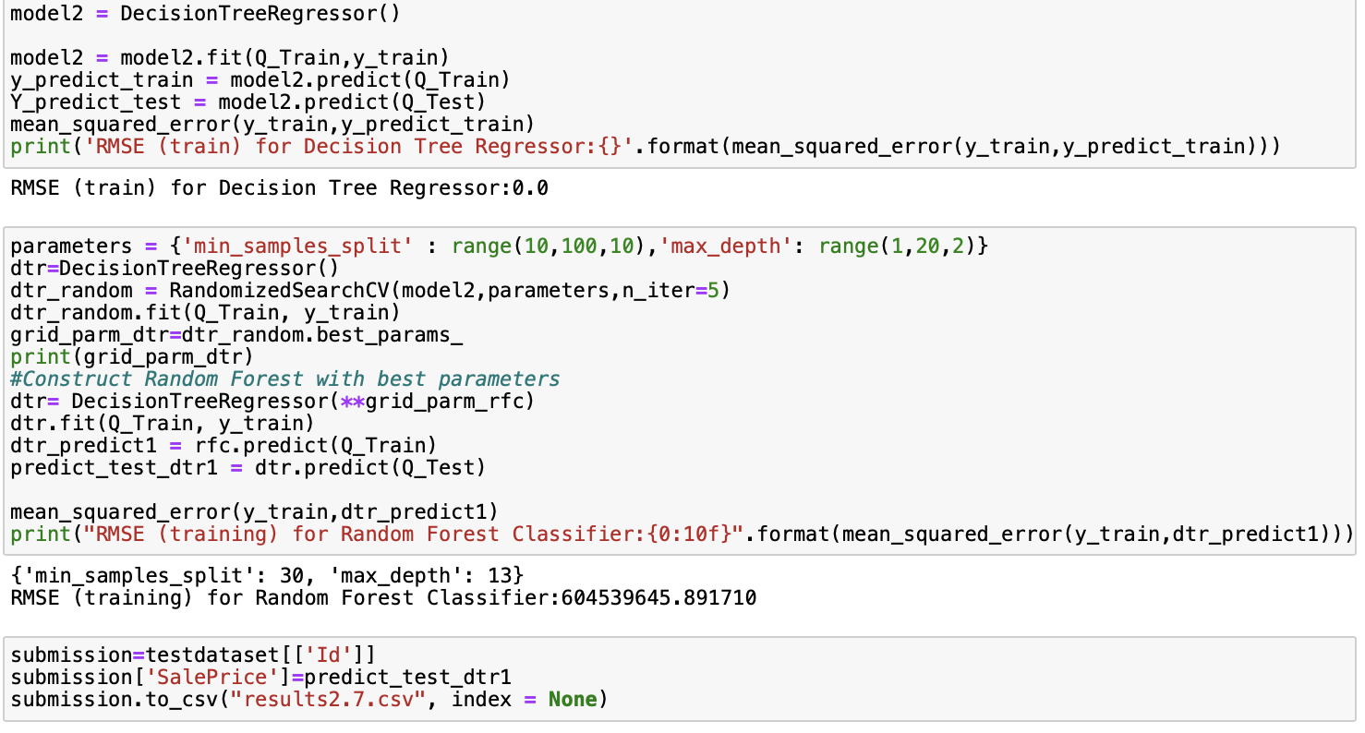
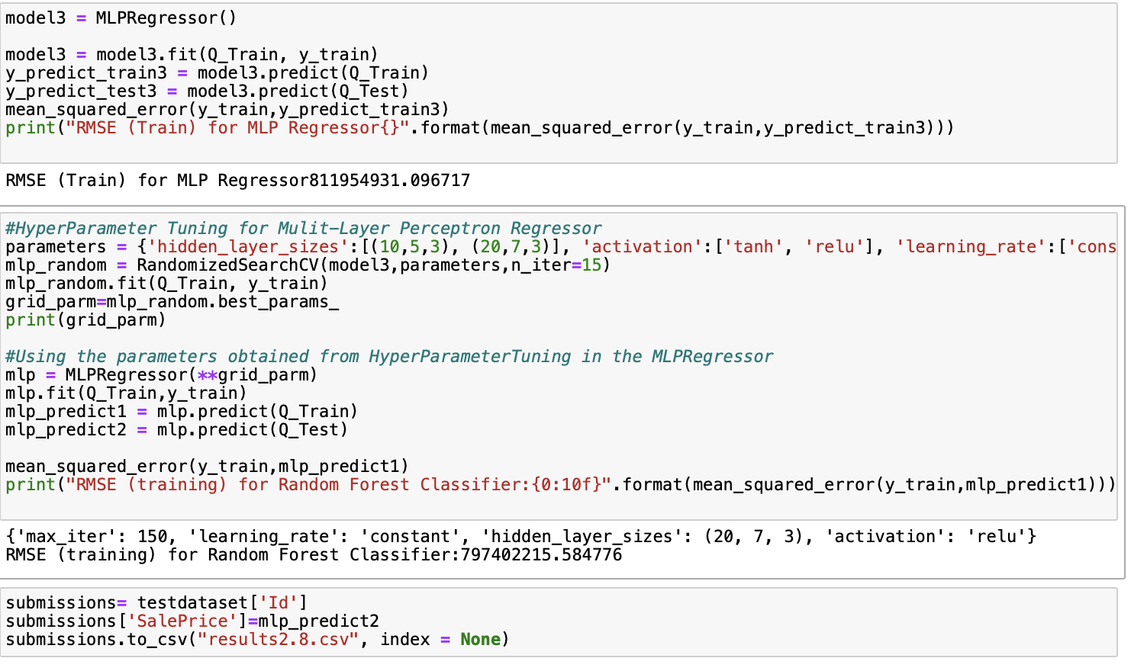

Slide 20
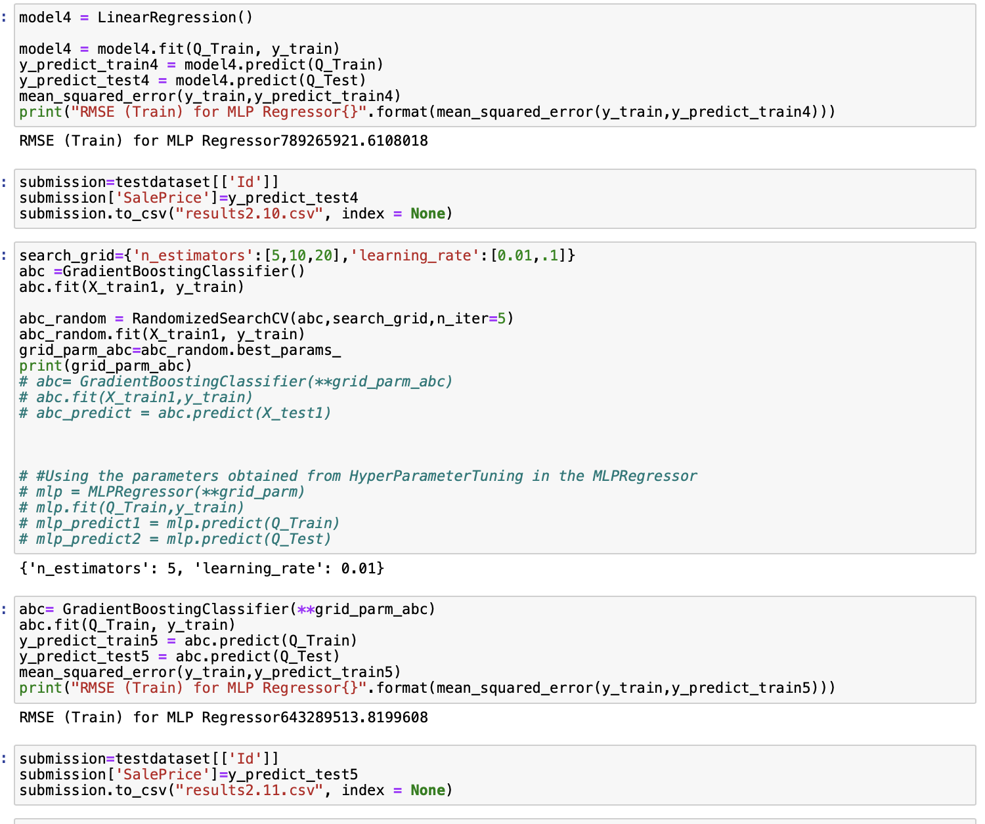

Slide 21
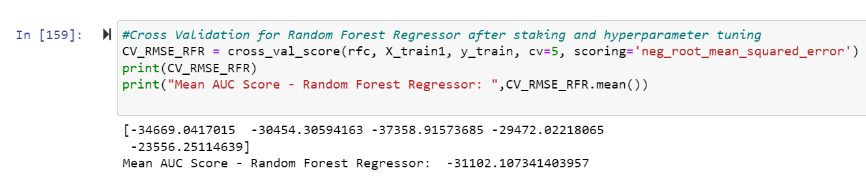
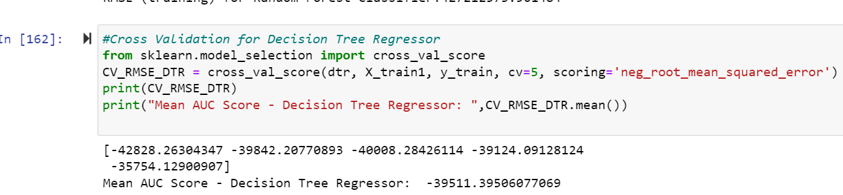
Cross Validation Of individual Models after Stacking And Hyperparameter tuning

Slide 22
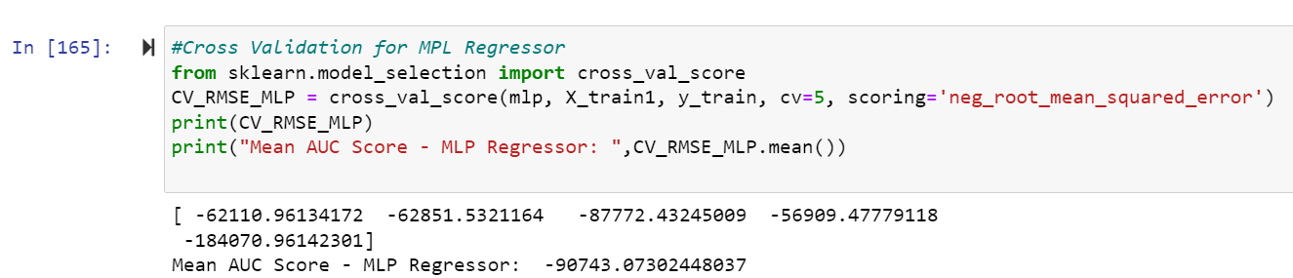
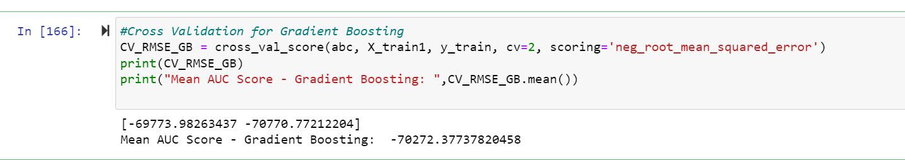

Slide 23
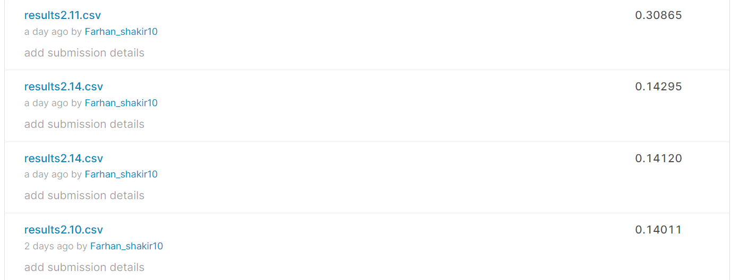
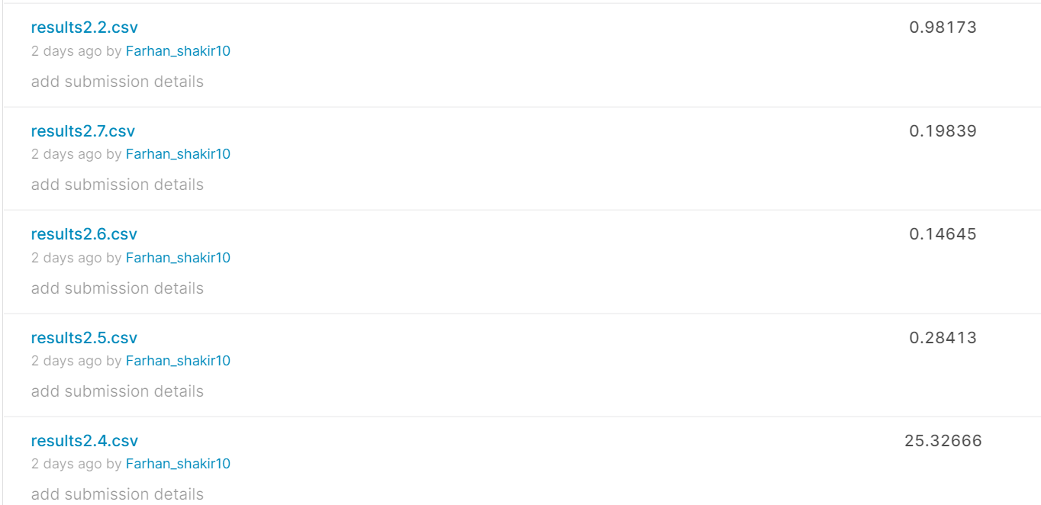
Kaggle Submission

Slide 24
Kaggle Scores
S.No | Submission | Score
1 | Decision Tree Regressor | 0.2201
2 | Random Forest Regressor | 0.15
3 | Linear regression | 0.44
4 | MLP Regressor | 0.28
5. | Gradient Boosting | 0.384
After Staking and Hyperparameter Tuning
6 | Random forest Regressor | 0.146
7 | Decision Tree Regressor | 0.19
8 | MLP Regressor | 0.1401
9 | Gradient Boosting | 0.3086

Slide 25
OBSERVATIONS
Stacking various linear regressions together decreased error rates.
The most improvement occurred when stacking together more dissimilar predictors.
Mlp classifier and random forest classifier gave the best results after performing hyper parameter tuning on the stacked model.

Slide 26
THANKYOU

